Slide 1
Types of Software License
Intellectual Property Laws
And Software

Slide 2
U.S. Copyright Law
The author of any program automatically owns the copyright of a program.
It is illegal to copy or share a program without the author’s permission.

Slide 3
Types of Licenses (from most restrictive to least)
Commercial
Subscription
Shareware
Adware
Freemium
Freeware
Open Source

Slide 4
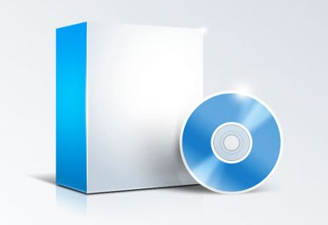
1. Commercial Software
Programs are sold to the user, usually to run on only one computer.
Sometimes “maintenance fees” are charged so the user has “free” updates to new versions.
Microsoft Windows and Office are examples of commercial software.

Slide 5
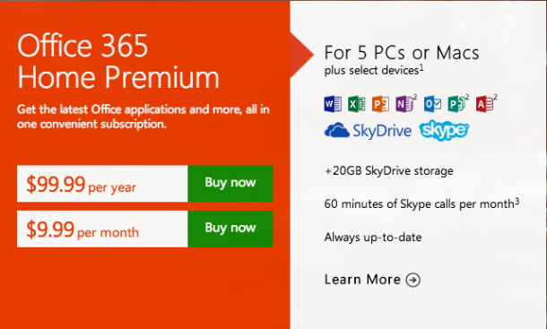
2. Subscription Pricing
Software is leased to the user for a monthly fee.
Once the user stops paying the monthly fee, he/she can no longer use the software.
Adobe Suite is an example of subscription software.

Slide 6
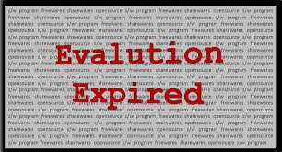
3. Shareware
The user has a 30-day trial to evaluate the software after which the program stops working.
Some shareware, or “nagware”, asks for you to voluntarily register the program if you find it useful.

Slide 7
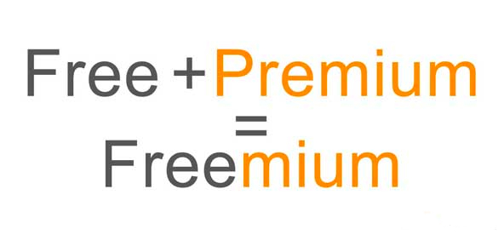
4. Freemium Software
The application is given away for free.
Some important features (ability to save or print) are disabled.
Users can pay for the premium features.

Slide 8
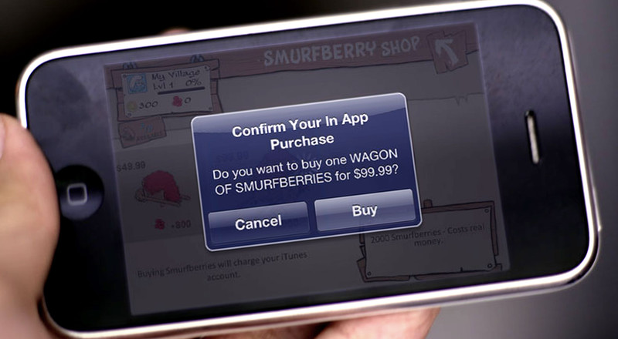
5. In-App Purchases

Slide 9

5. Freeware
The software creator decides to give away the software not expecting any payment.
The original source code is not shared with the public.
The advantage to the developer is name exposure. Customers may investigate other applications that the developer sells.

Slide 10

6. Open Source
Software is not only free, but the original source code is published.
You may modify the code (if you know how to program).
Open source projects are often collaboration projects by volunteer programmers.

Slide 11
Open source alternatives to…
Windows – Ubunto
Chrome - Firefox
Microsoft Office – OpenOffice
Adobe Audition - Audacity
Adobe Photoshop – GIMP, Paint.net,
Adobe Illustrator - Inkscape
Use http://alternativeto.net/
To find alternative versions to almost every program imaginable.

